Slide 1


Slide 2
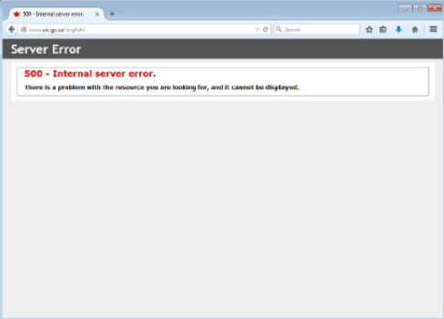

Slide 3
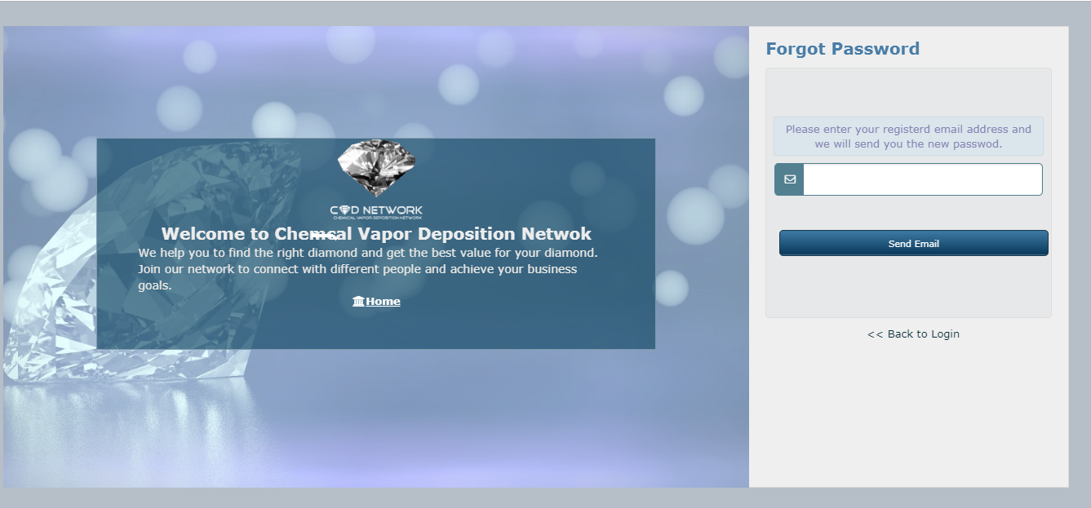

Slide 4
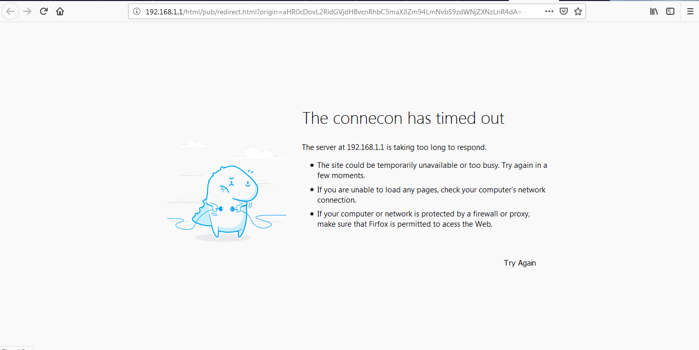

Slide 5
Severity & Priority
Severity shows how bad the bug is and reflects its impact to the product and to the user. It refers to the impact of the bug's presence or of the feature's absence (in the case of enhancement requests). Bugs that can screw up user data, damage hardware, or create a permanently un-recoverable situation have highest severity.

Slide 6
Classification of severity
1. Blocker - Reserved for catastrophic failures - exceptions, crashes, corrupt data, etc. that (a) prevent somebody from completing their task, and (b) have no workaround. These should be extremely rare. They must be fixed immediately (same-day) and deployed as hotfixes.
2. Critical - These may refer to unhandled exceptions or to other "serious" bugs that only happen under certain specific conditions (i.e. a practical workaround is available). No hard limit for resolution time, but should be fixed within the week (hotfix). They key distinction between (1) and (2) is not the severity or impact but the existence of a workaround.
3. Major - Usually reserved for perf issues. Anything that seriously hampers productivity but doesn't actually prevent work from being done. Fix by next release.
4. Minor - These are "nuisance" bugs. A default setting not being applied, a read-only field showing as editable (or vice-versa), a race condition in the UI, a misleading error message, etc. Fix for this release if there are no higher-priority issues, otherwise the following release.
5. Trivial - Cosmetic issues. Scroll bars appearing where they shouldn't, window doesn't remember saved size/location, typos, last character of a label being cut off, that sort of thing. They'll get fixed if the fix only takes a few minutes and somebody's working on the same screen/feature at the same time, otherwise, maybe never. No guarantee is attached to these.

Slide 7
Priority
Priority refers to our development schedule. Priority is how soon the issue needs to be resolved.. A high-priority bug or feature is one that is scheduled for completion in the current development cycle or has been promised to a customer by a certain, relatively soon date.

Slide 8
Why & how do we prioritize?
Out of a large cluster of test cases in our hand, we need to scientifically decide their priorities of execution based upon some rational, non-arbitrary, criteria. We carry out the prioritization activity with an objective to reduce the overall number of test cases in the total testing feat.
During prioritization we work out plans addressing following two key concepts:
Concept – 1: Identify the essential features that must be tested in any case.
Concept – 2: Identify the risk or consequences of not testing some of the features.
The objective of the test case prioritization exercise is to build confidence among the testers and the project leaders that the tests identified for execution are adequate from different angles.
The list of test cases decided for execution can be subjected to n-number of reviews in case of doubts / risks associated with any of the omitted tests.

Slide 9
Classification of priority
Priority can be categorized into the following levels:
Urgent: Must be fixed immediately / in the next build.
High: Must be fixed in any of the upcoming builds but should be included in the release.
Medium: May be fixed after the release / in the next release.
Low: May or may not be fixed at all.
Priority is also denoted as P1 for Urgent, P2 for High and so on.

Slide 10
Priority 1 - All work stops except for this item, we release the fix as soon as it is tested.
Priority 2 - The next release will not go out without this item resolved.
Priority 3 - Really desired in this release, but if we run out of time we will push it.
Priority 4 - We really don't expect to get to this in this release, but if you run out of tasks, work on it.
Priority 5 - Don't work on it.

Slide 11
.
Priority: Priority is related to business and revenue.” Priority of a bug is defined by its impact on business. If any thing is related to business then priority of a bug should be defined by Manager and Some higher entity in business( It includes Manager, Architect, team lead).
Severity: Severity of a bug is decided by its impact on application and theoretically it is decided by tester.
Normally, Testers have the final say on Defect Severity while the Project Management / Product Management /Client has the final say on Defect Priority.

Slide 12
Why do we need both Priority and Severity?
You can have a UI bug that doesn't really affect the apps usability (low severity), but is a high priority because it's ugly. You can have a bug that crashes the app completely (high severity) but is a low priority because the conditions to make it happen are one in a million and in all practical terms will never actually happen
If you have a sale to make to an important government agency that requires high performance but won't ever use module X, then it makes a lot of business sense to fix a minor database availability error sooner than a severe error in the X module.

Slide 13
Date and time bugs
Bug: Year-end processing will totally corrupt your database. That's clearly a severe bug.
Date: December 15. The bug is very high priority.
Date: February 1. The bug is low priority.
bug A will take 30min to fix and has 'low' severity; bug B may take 2+ weeks to fix and have 'high' severity. In addition, bug B may take a lot of discussion and coordination in dev team and perhaps outside of team; bug A may be fixed by single dev immediately. It's perfectly fine to set higher priority on bug A.

Slide 14
Important terms
Priority inversion bugs are where a process of higher priority is waiting on a lock held by a process of lower priority.
To fix a priority inversion we sometimes need to identify the low priority thread holding a resource and give it a quantum priority boost.
Defect triage is a process where each bug is prioritized based on its severity, frequency, risk, etc. Triage term is used in the Software testing / QA to define the severity and priority of new defects.

Slide 15
Difference between Priority and Severity
Priority | Severity
Defect Priority is defined the order in which the developer should resolve a defect | Defect Severity is defined as the degree of impact that a defect has on the operation of the product
Priority is categorized into three types Low Medium High | Severity are categorized into five types Critical Major Moderate Minor Cosmetic
Priority is associated with scheduling | Severity is associated with functionality or standards
Priority indicates how soon the bug should be fixed | Severity indicates the seriousness of the defect on the product functionality
Priority of defects is decided in consultation with the manager/client | QA engineer determines the severity level of the defect
Priority is driven by business value | Severity is driven by functionality
Its value is subjective and can change over a period of time depending on the change in the project situation | Its value is objective and less likely to change
High priority and low severity status indicates, defect have to be fixed on immediate bases but does not affect the application | High severity and low priority status indicates defect have to be fixed but not on immediate bases
Priority status is based on the customer requirements | Severity status is based on the technical aspect of the product
During UAT the development team fix defects based on priority | During SIT, the development team will fix defects based on the severity and then priority

Slide 16
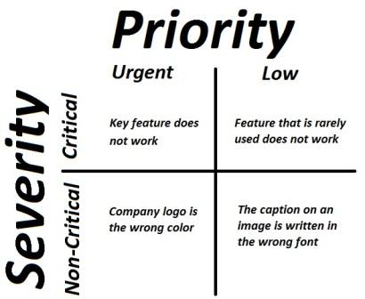

Slide 17
Examples
1- High Priority and High Severity:
Suppose someday, not a single person able to login in to his/her g gmail account then this gonna jolt the business of google and it also seems a big jolt to its mailing application. So this will be of high priority and high severity
An error which occurs on the basic functionality of the application and will not allow the user to use the system. (Eg. A site maintaining the student details, on saving record if it, doesnât allow to save the record then this is high priority and high severity bug.)
For an email service provider compose box is not open , mail is not going to recipient or Bcc .
If ATM machine has bug like when user withdraw money from same bank ATM for which he is holding bank account, He is getting charged by 20 rs per transaction. Which is invalid as bank policy says withdrawing money from owns bank ATM no charge will be applied.
So this bug ishigh priority because Bank is charging 20 rs per transaction for own ATM which is opposite to business logic.
and bug is high severity this bug need to resolved immediately because thousands of user withdraw money per hour so it cost high.

Slide 18
2- High Priority and low severity : Suppose one day we all people wake up in the morning and just open our laptop and entered url http://google.com and as soon home page of google opens and spelling of colored google looks like FFFFOOOGHEL. Then this will be enough for a person pron to google search to throw him in shock. This will give big blow to google search, but search is still working so this bug will be of high priority and low severity
For an email service provider spelling mistake in its Logo like hotmail is hatmail ,gmail is qmail
Suppose on 2nd Oct on occasions of Gandhi jayanti (Last date to do saving is 3rd oct) bank is giving 0.5% extra (basic 5 % + additional 0.5%= 5.5%) additional interest for senior citizens on savings. This advertisement need to flash on or before 3rd oct. Suppose you visited ATM on 4th Oct morning and still you are seeing this add and date displaying in advertisement is 3rd oct last date to do savings.
Here priority is high as advertisement is flashing on multiple ATMs after end of date to do savings. and Impact is not much as date displaying in advertisement 3rd oct means scheme is already over so severity is low

Slide 19
3- Low priority and high severity :
Suppose any calculator start giving wrong calculation when calculation takes input more than 18 digit. Since common use don’t go to this extent so this can be fixed in next release but this is calculation mistake so it should be taken on high priority
System crashes 25% of the time on startup for an application that is being retired next week.
WindowsXP
Accidental launch of missile bug
Bug: ICBM control software pukes when going from Feb 28 to Mar 1 in years divisible by 4. The result is an uncommanded launch.
That's about as severe a bug as can exist. Priority very low, though--is there any realistic chance the software will be in use when the condition is triggered?
Logo of the company
For an email service provider if u sign up and click Terms and Condition page and it is not displaying . its severity is high because functionality is not working but not any business impact on Gmail

Slide 20
This is the best example for low priority and high severity bug. Lest’s think there is Banking application who gives interest of rs 2 for every 1000 rs in account on the last day of year. Means on last day of year 31.12.YYYY the bank will deposit 2 rs interest for every 1000rs in account. Now bank found a bug that instead of 2 rs application giving interest of 4 rs for every 1000 rs in account. Means due to bug interest is going double.
This bug is high severity – Due to bug interest is going double and bank may have thousands of accounts, So it will not be profitable for bank.
This bug is Low priority – Depositing interest is happen on last day of year so if its beginning of year like January then there is lot of time to solve this bug .
System is crashing in the one of the corner scenario, it is impacting major functionality of system so the Severity of the defect is high but as it is corner scenario

Slide 21
4- Low priority and Low severity:
Suppose there is spelling mistake in Advertising Programs since user normally don’t see such spelling mistakes so its low priority and low severity bug
Spelling mistakes like if today you open login page of Facebook and select language Punjabi fields are showing in English language “Re enter your password “
Color, Font, Spelling, grammar mistake

Slide 22
The program becomes unusable or crashes when I do something.
The program has a graphical defect that affects functionality.
The program does not allow me to do something I should be able to do. The program allows me to do something I shouldn't be able to do.
The program gives the wrong result when I do something.
The program takes too long to do something.
The program has a graphical defect that does not affect functionality.
The program has a defect that does not fit in one of the above categories.
To give examples:
My iPhone crashes when I receive a message containing Hebrew symbols.
My Android lock screen is rotated in such a way that half of it falls of the screen.
My Android phone sometimes doesn't accept my lockscreen code, even though I entered the right code.
When I try to navigate to PhoneHub.net, my phone redirects me to an adult site.
When I open the Facebook app, it takes a minute to open, even on fast connections and with no other apps running.
Your app has a spelling error.
I found a security defect in your program and would like to report it.

Slide 23
Questions?

Slide 25
The definition of "Critical feature" also changes. Say, you are working on version #15 of your product, and it has planned feature of A. According to your plans, there will be another feature B scheduled for version #16. You find a failure in feature B, and you need assigning severity. Regardless of the fact B will become critical for release #16, it is not that important for current release. So you assign it medium severity so that the developers were not wasting their time now. As soon as release #15 occurs, the severity should be updated.
Client visit essential features

Slide 26
It goes a bit like this:
Mgr: what are you working on? Dev: this low priority tasks Mgr : shouldn't you be working on high priority tasks?
Client: when will my bug be fixed? Dev: it's low priority we have high priority tasks. Client: oh, well then set my bug status to high priority.
This will lead to ever escalating levels of priority. I see you've already gone beyond high priority to very high priority. What will be next are:
Super High Priority
Ultra High Priority
Very Super Ultra High Priority.
Very Super Ultra Mega High Priority.
etc. etc.
Yes, this is a normal process. As long as there is no cost involved with assigning priority, and the caller has influence, of course they will try get their issue resolved in the fastest way and set the highest priority.
There are basically 2 ways to counter this:
Take control away from the client regarding priority levels.
Associate a cost to the client for elevated priority levels.

Slide 27
A popular three-level priority categorization scheme is described as under
Priority – 1: Allocated to all tests that must be executed in any case.
Priority – 2: Allocated to the tests which can be executed, only when time permits.
Priority – 3: Allocated to the tests, which even if not executed, will not cause big upsets.

Slide 28
Severity 1 - Catastrophic defect that causes total failure of the software or unrecoverable data loss. There is no work around. In general, a severity 1 defect would prevent the product from being released. Example: defects that cause the system to crash, corrupt data files, or completely disrupt service.
Severity 2 - Defect results in severely impaired functionality. A work around may exist but its use is unsatisfactory. In general, you would not release the product with such a defect. Examples: with certain steps, we may generate a Windows error/message that you can click Ok on and continue with whatever you were doing with no harmful effects.
Severity 3 - Defect causes failure of non-critical aspects of the system. There is a reasonably satisfactory work around. The product may be released if the defect is documented, but the existence of the defect may cause customer dissatisfaction. Example: a non Client Financial Report is not recognizing an option correctly, but if a filter is set, the report can be generated with the proper output.
Severity 4 - Defect of minor significance. A work around exists or, if not, the impairment is slight. Generally, the product could be released and most customers would be unaware of the defect's existence or only slightly dissatisfied. Example: A button or button set is slightly off center on a data screen, or the problem is purely cosmetic and not easily recognizable.
Severity 5 - Enhancement request or design issue. These should probably be coded as Suggestions or brought to the Design Team by the originating person’s DT representative.

Slide 29
Priorities Priority 1: Immediate - Blocks further testing (QA/QT) - Currently very visible and/or deterimental to customers (CC) - Possibly immediately detrimental to revenue or reputation (Sales, Marketing, QA) - Needed for time critical deadline (sale, expo, trade show, etc.) (QA, Sales, Marketing)
Priority 2: High - must fix before next release because of: - numerous customer complaints about the issue (CC) - critical area of the system (Dev/QA) - will be very visible and/or deterimental when released (QA/QT/Dev) - does not conform to what was stated as a requirement for the release (QA)
Priority 3: Medium - should fix if time permits; not a critical areas of the system (Dev/QA) - some customers are impacted by it but there is a workaround (Dev/CC/QA) - very few customer complaints logged about this issue (CC)
Priority 4: Low - would like to fix but can be released as is; trivial, cosmetic (Dev, QA/QT, Marketing) - few customers even notice it much less are impacted by it (i.e., not very visible or deterimental) (CC)

Slide 30
Classification
The actual terminologies, and their meaning, can vary depending on people, projects, organizations, or defect tracking tools, but the following is a normally accepted classification.
Critical: The defect affects critical functionality or critical data. It does not have a workaround. Example: Unsuccessful installation, complete failure of a feature.
Major: The defect affects major functionality or major data. It has a workaround but is not obvious and is difficult. Example: A feature is not functional from one module but the task is doable if 10 complicated indirect steps are followed in another module/s.
Minor: The defect affects minor functionality or non-critical data. It has an easy workaround. Example: A minor feature that is not functional in one module but the same task is easily doable from another module.
Trivial: The defect does not affect functionality or data. It does not even need a workaround. It does not impact productivity or efficiency. It is merely an inconvenience. Example: Petty layout discrepancies, spelling/grammatical errors.
Severity is also denoted as:
S1 = Critical
S2 = Major
S3 = Minor
S4 = Trivial

